Slide 1
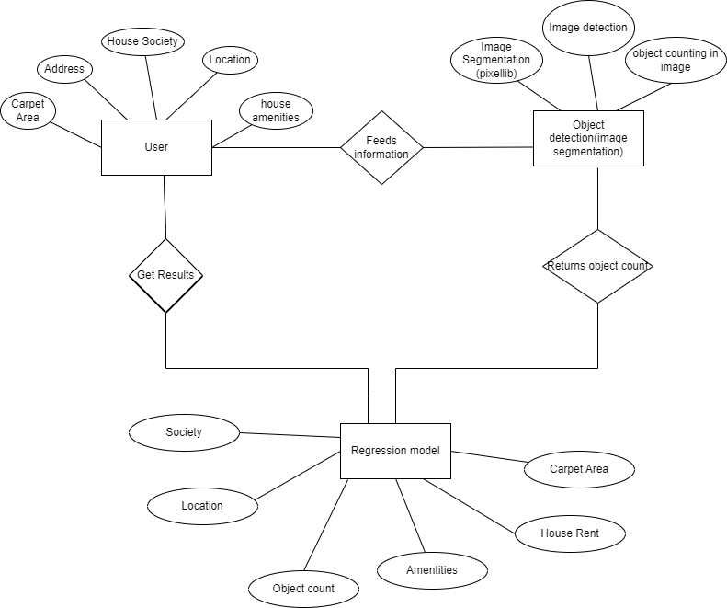
ER DIAGRAM

Slide 2
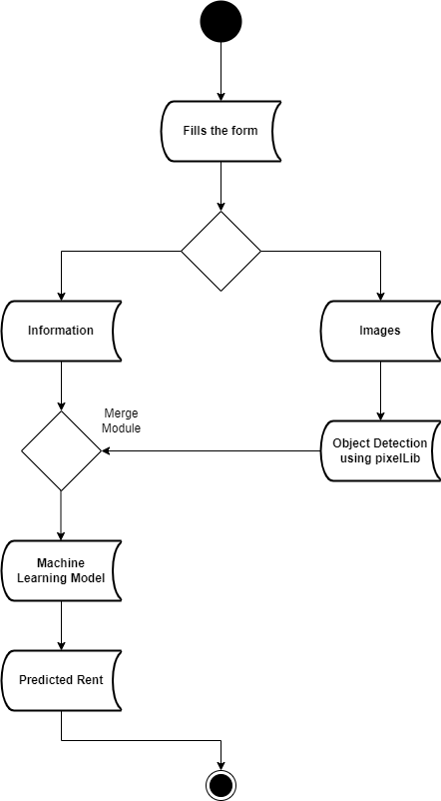
ACTIVITY DIAGRAM
Text
Images

Slide 3
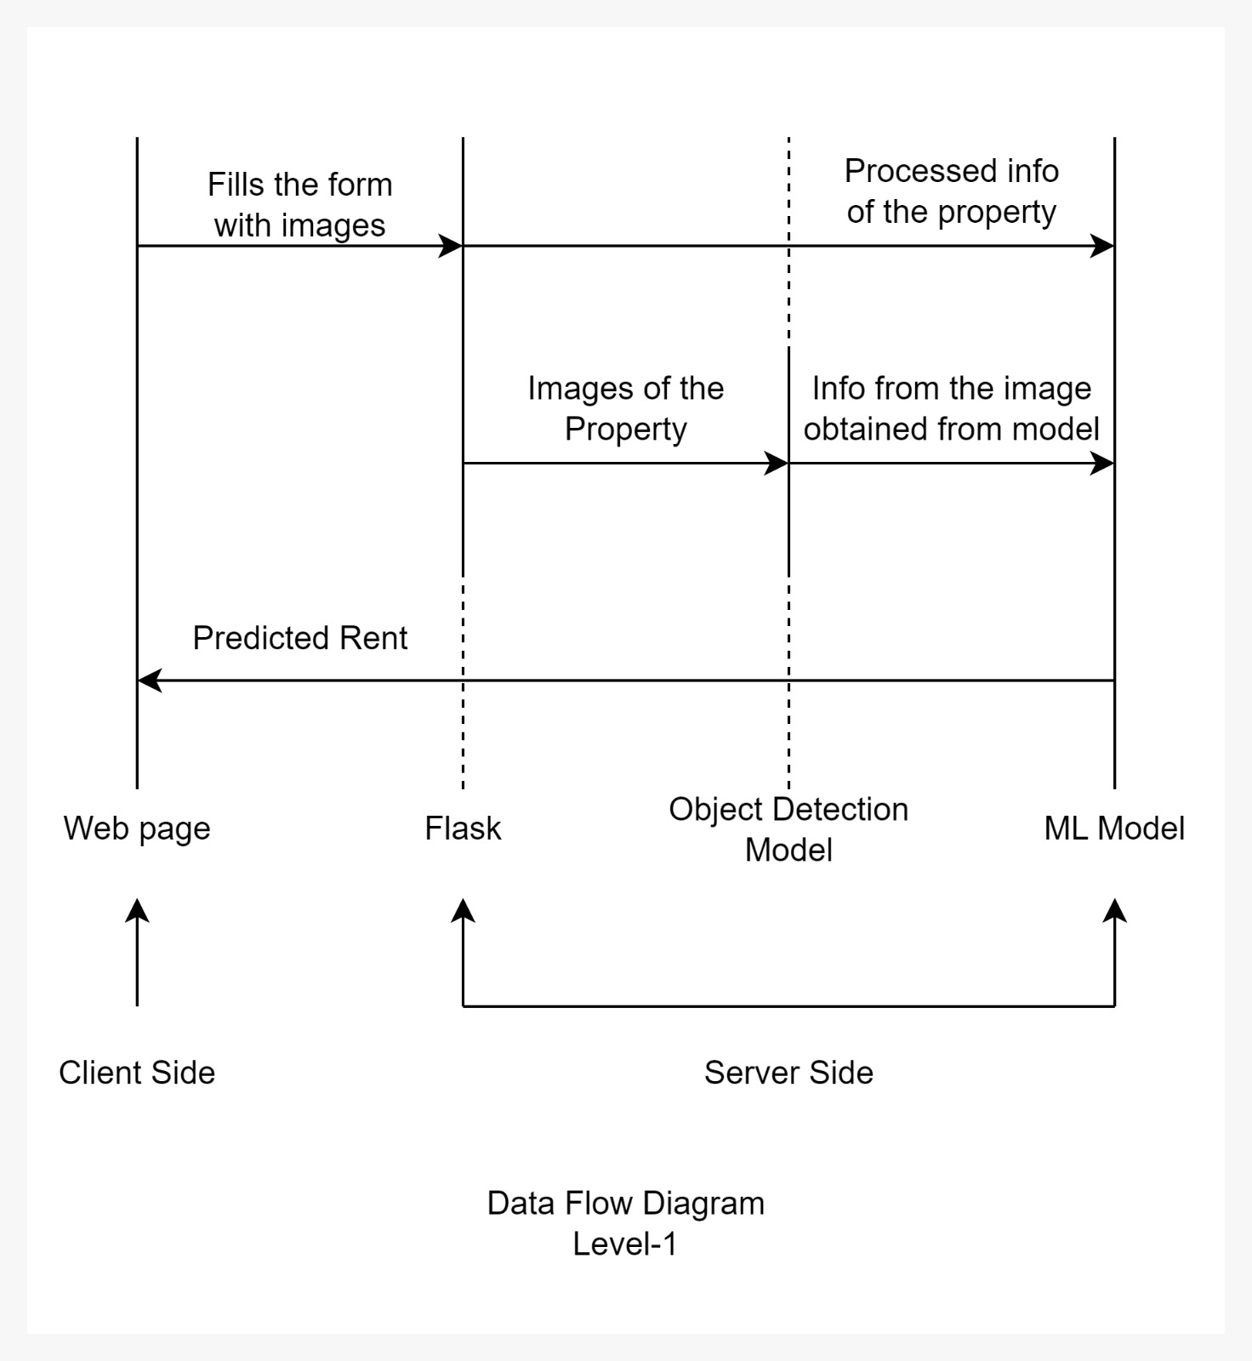
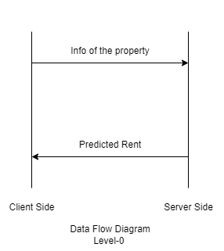
DATA FLOW DIAGRAMS

Slide 4
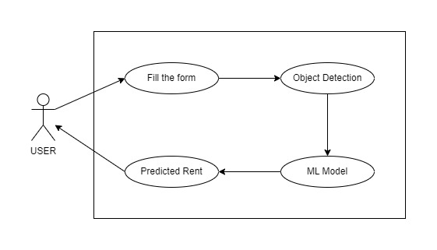
USE CASE DIAGRAM

